Slide 1
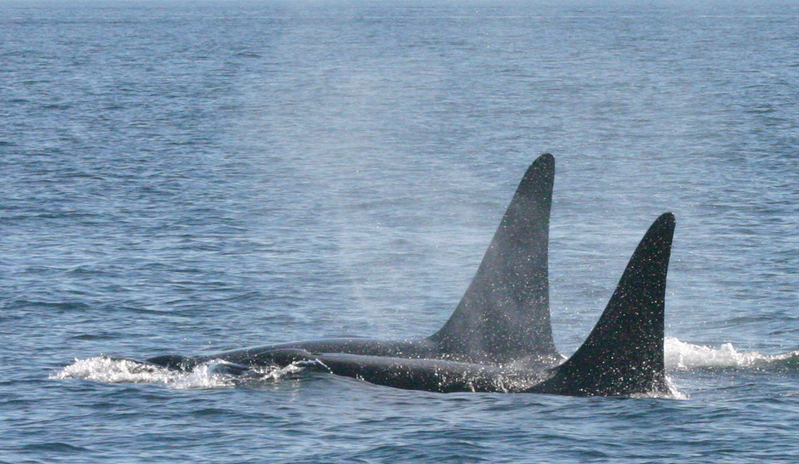
Energetic cost of behaviour in Ornicus orca: a non-invasive study of acoustic cues
Cat Peters
Beam reach sustainability school
Fall 2010

Slide 2
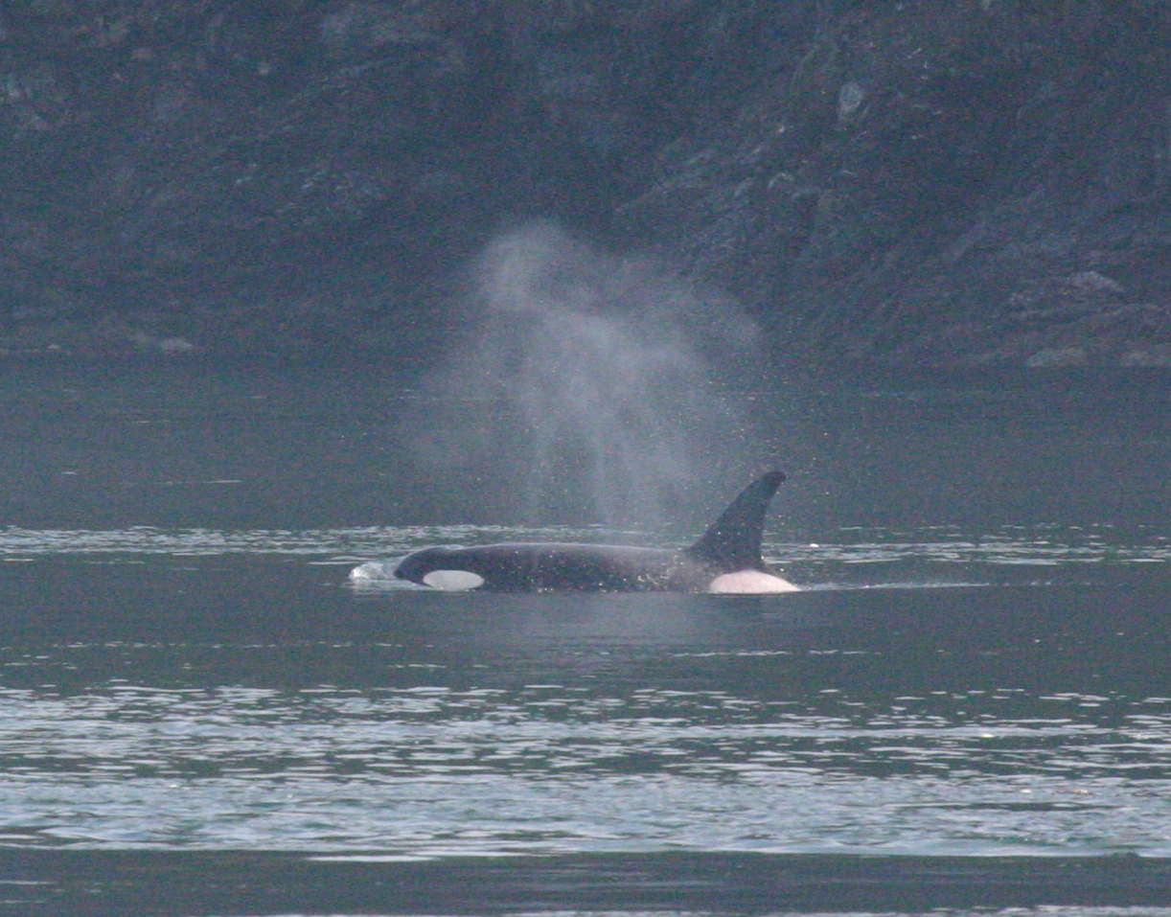
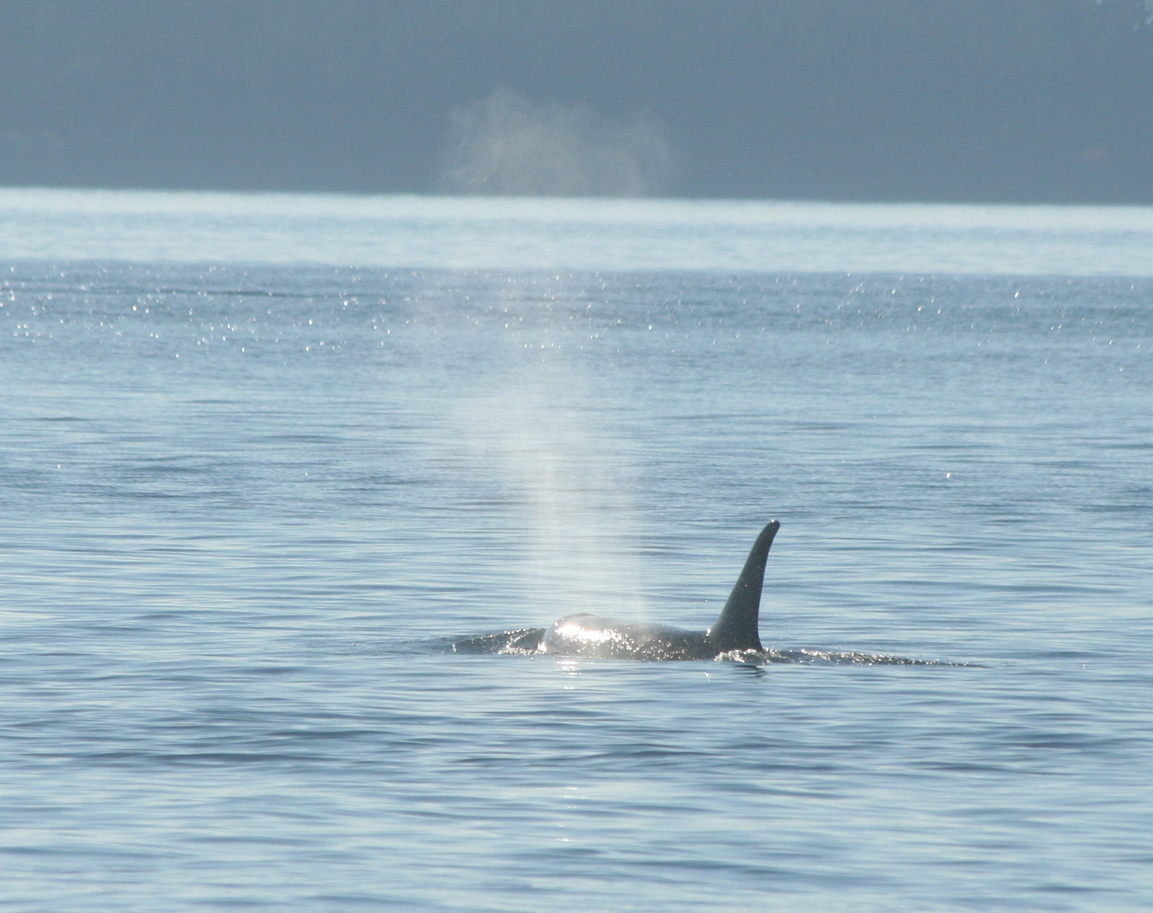
Background
Acoustic cues
sounds produced as a result of physiological or locomotive needs, and are not produced to provide a benefit to either the sender or receiver.
Energetics
The flow and transformation of energy within a system.
Why study blows?

Slide 3
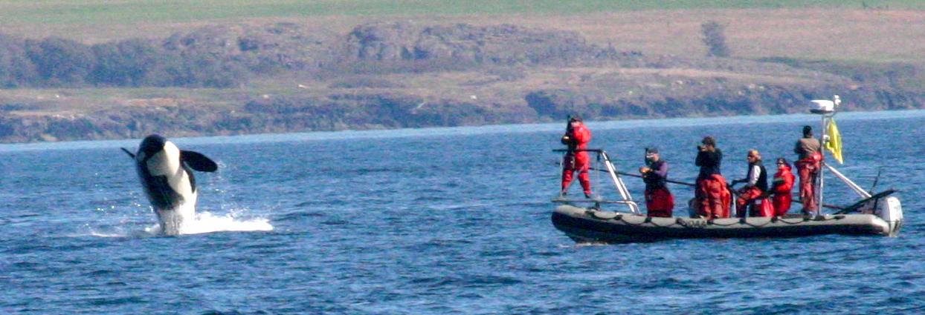
Hypotheses
Foraging, travel and socialising will have a higher estimated metabolic rate than resting and milling.
As dive length increases so will the energy required to perform that dive, and thus blow SEL will increase.
SEL is an appropriate measurement for this study. Shorter blows will have a higher intensity than longer blows.

Slide 4
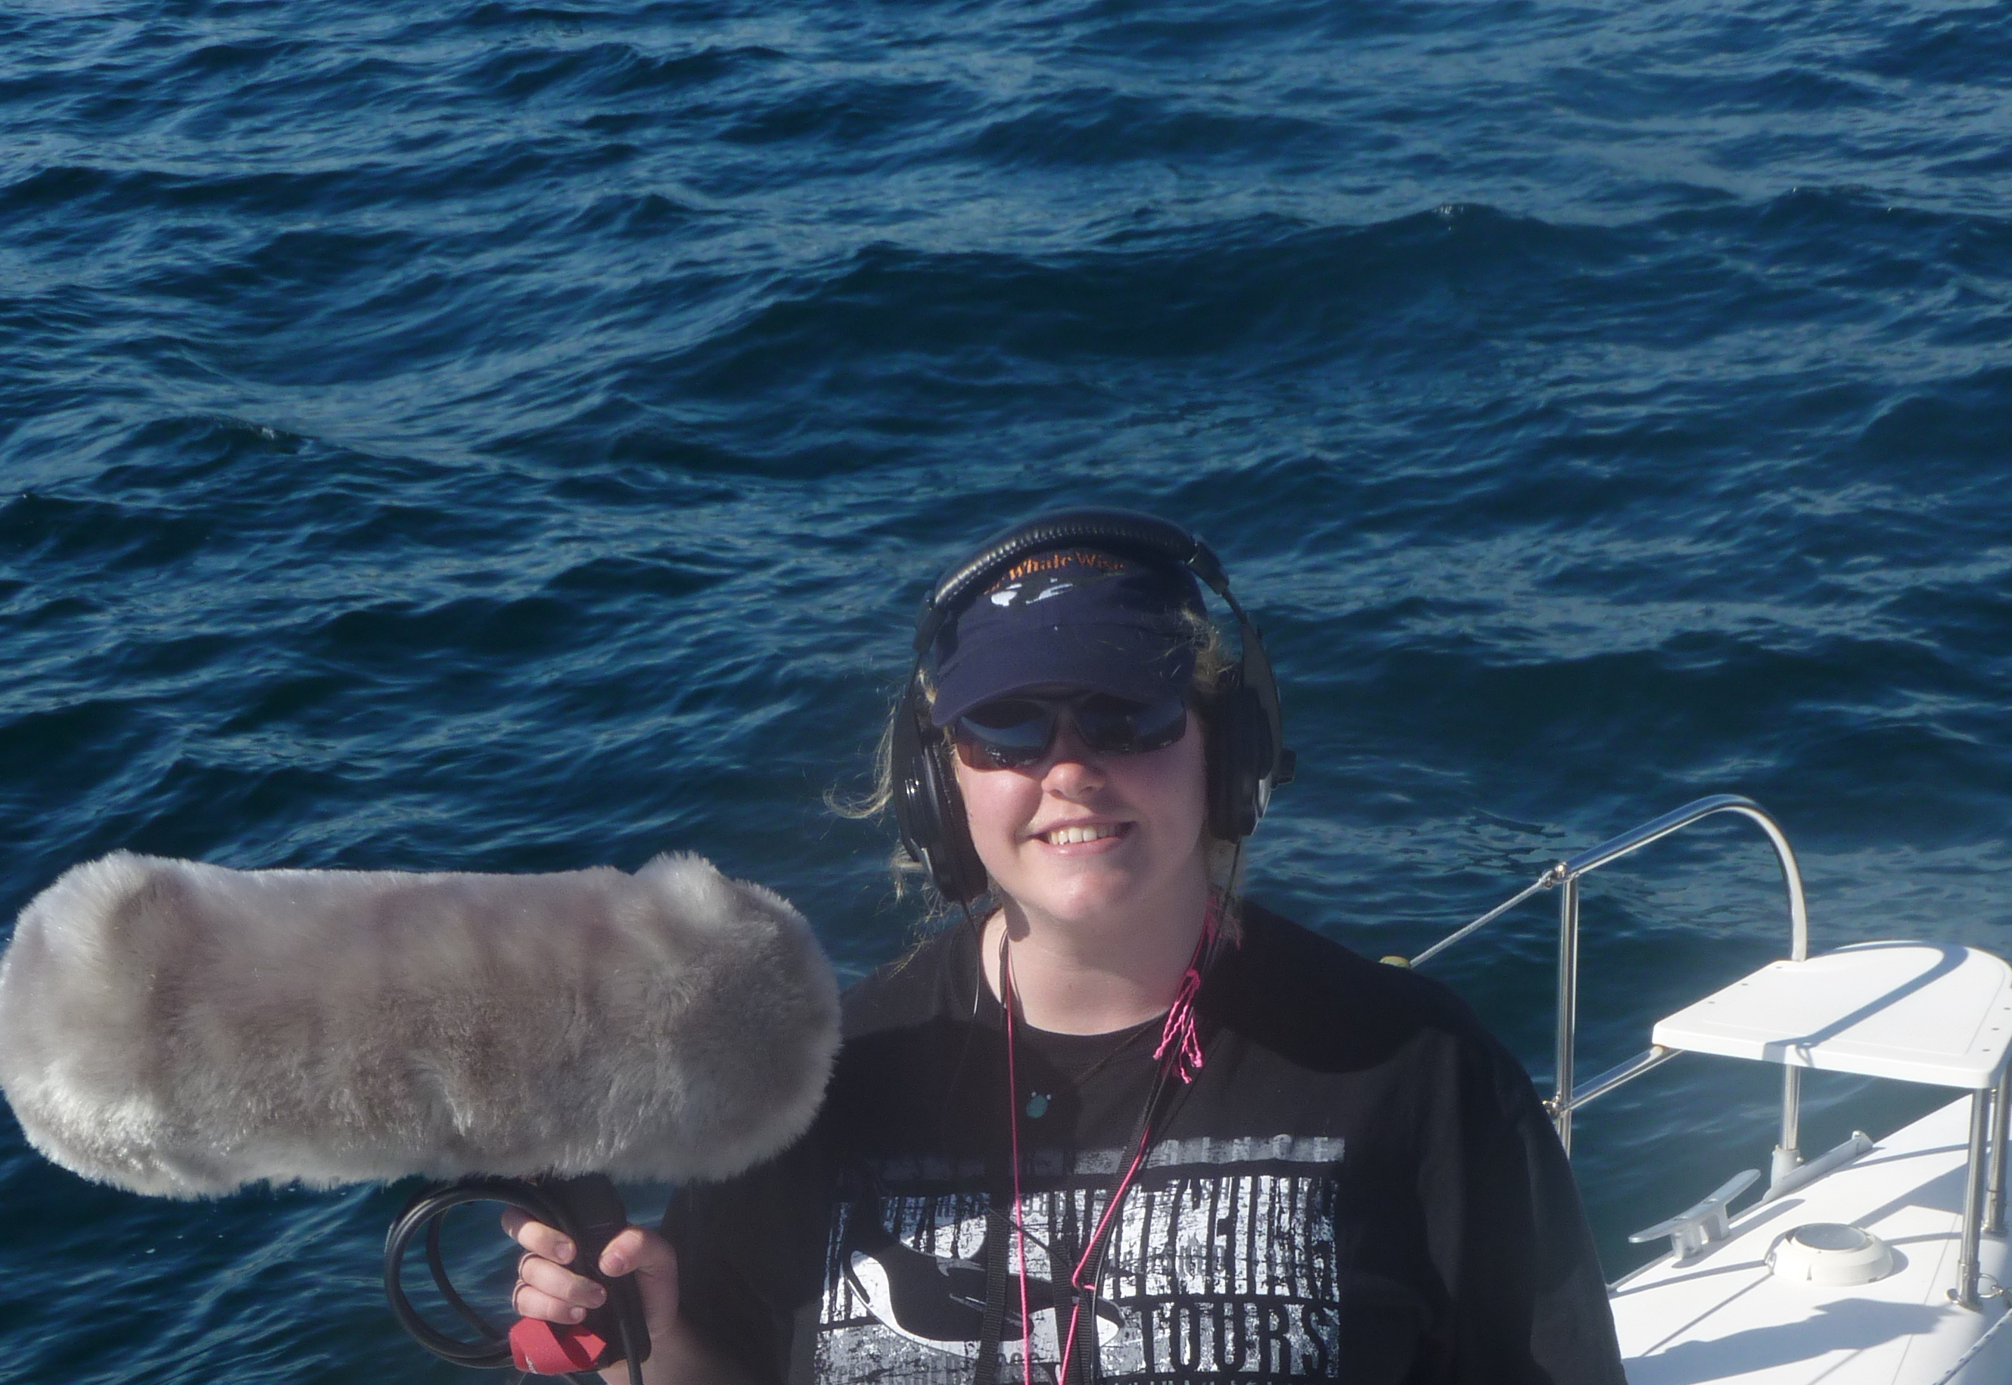
Data collection
‘The dead rabbit’
‘The parabola’

Slide 5
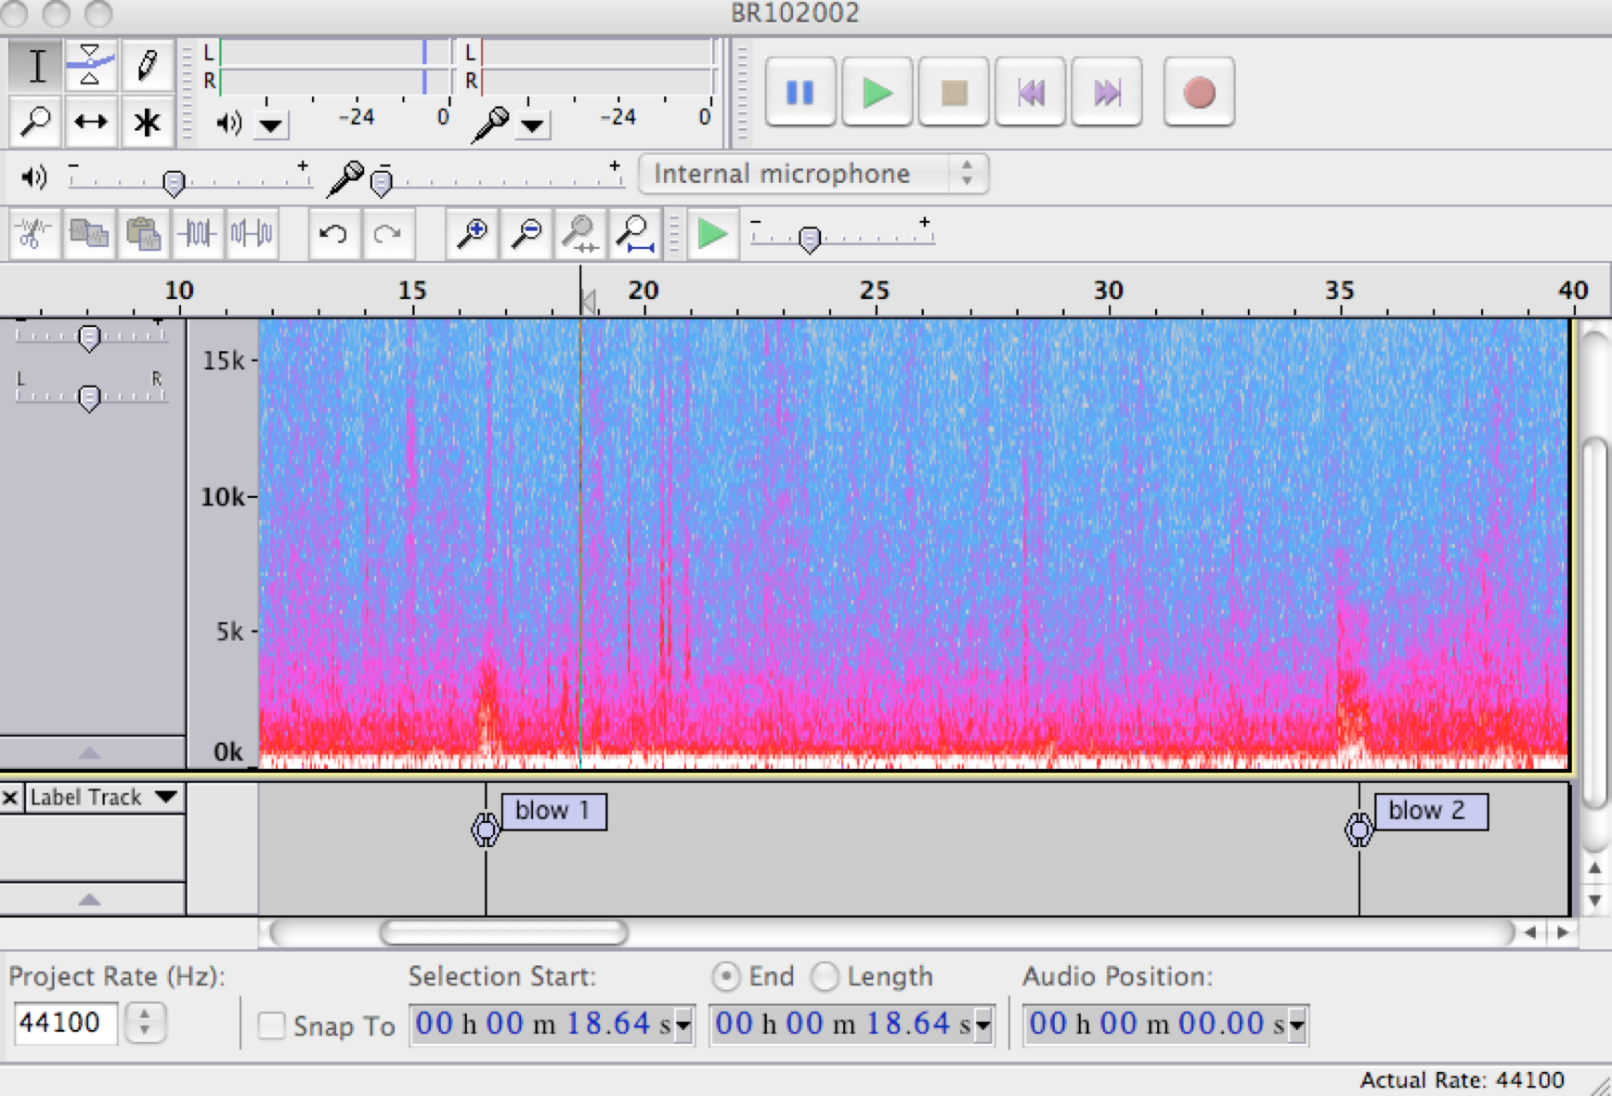
Data collection

Slide 6
Data analysis

Slide 7
Results – Behaviour
Gender differences? P=0.023

Slide 8
Results - Dive length

Slide 9
Results – SEL

Slide 10
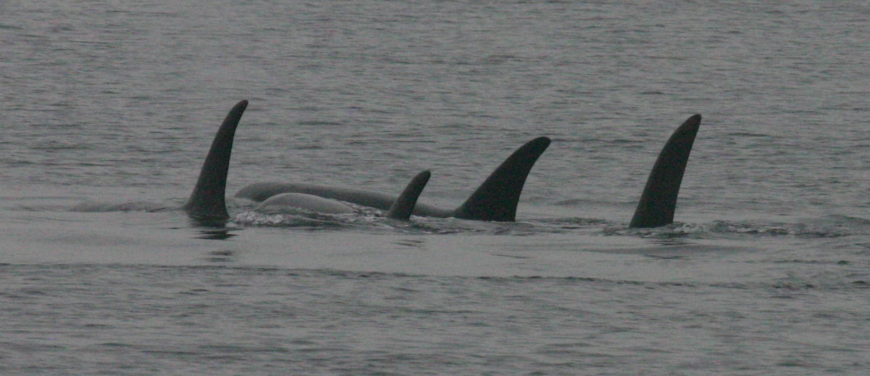
Discussion – Behaviour
Resting – Oxygen deficit, Time of recording, Day vs night, Surfacing in unison.
Traveling – Second most energetic, Different gaits.
Foraging – Lower than expected, Maximise foraging, Foraging vs milling.

Slide 11
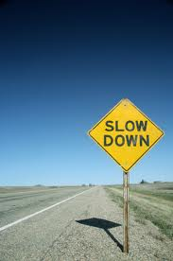
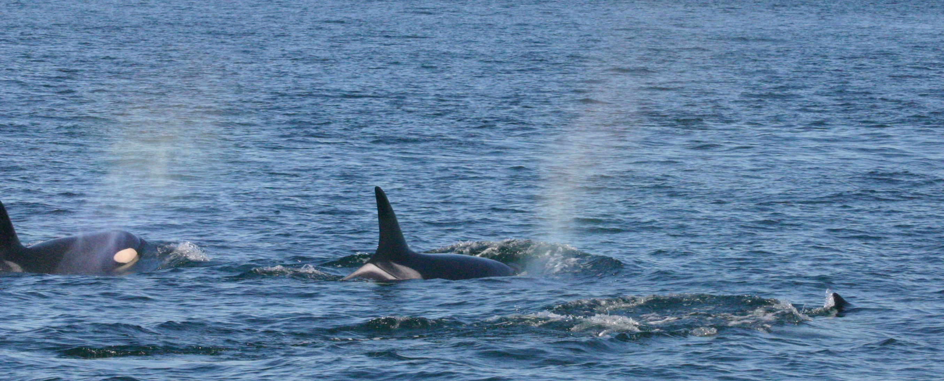
Discussion - Gender
Surface area to volume ratio
Mixed pod social structure
Bottlenose dolphins (Lusseau 2007)

Slide 12
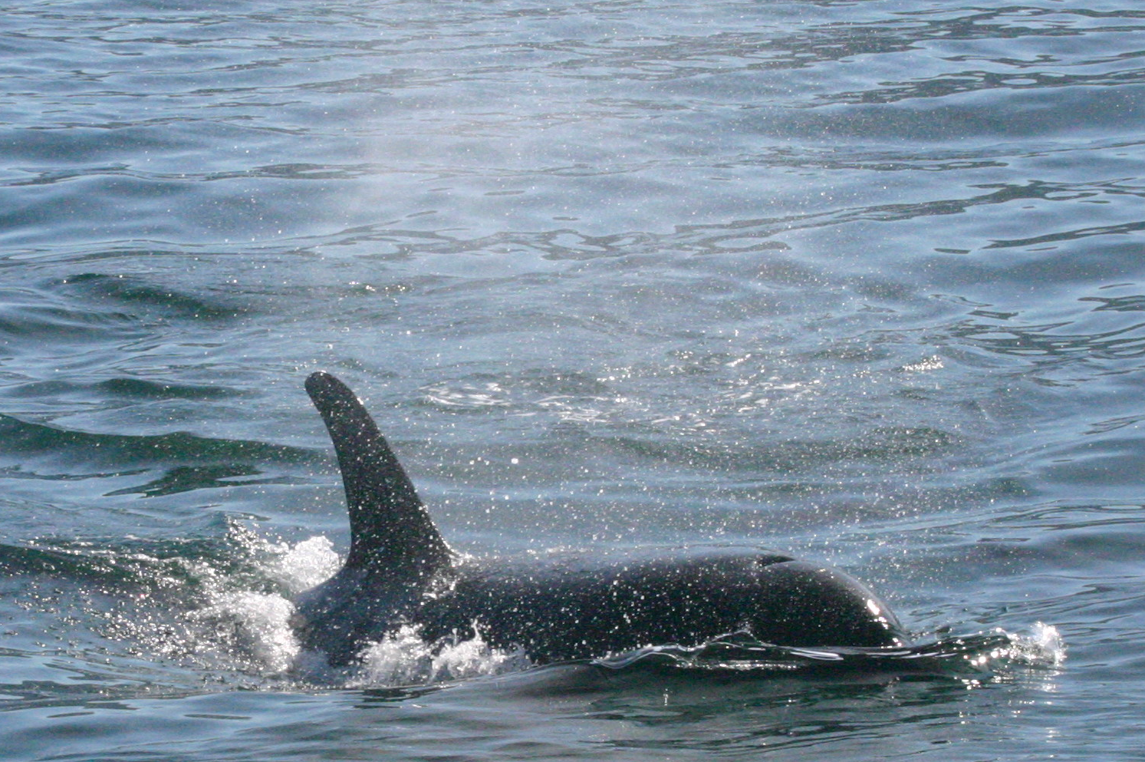
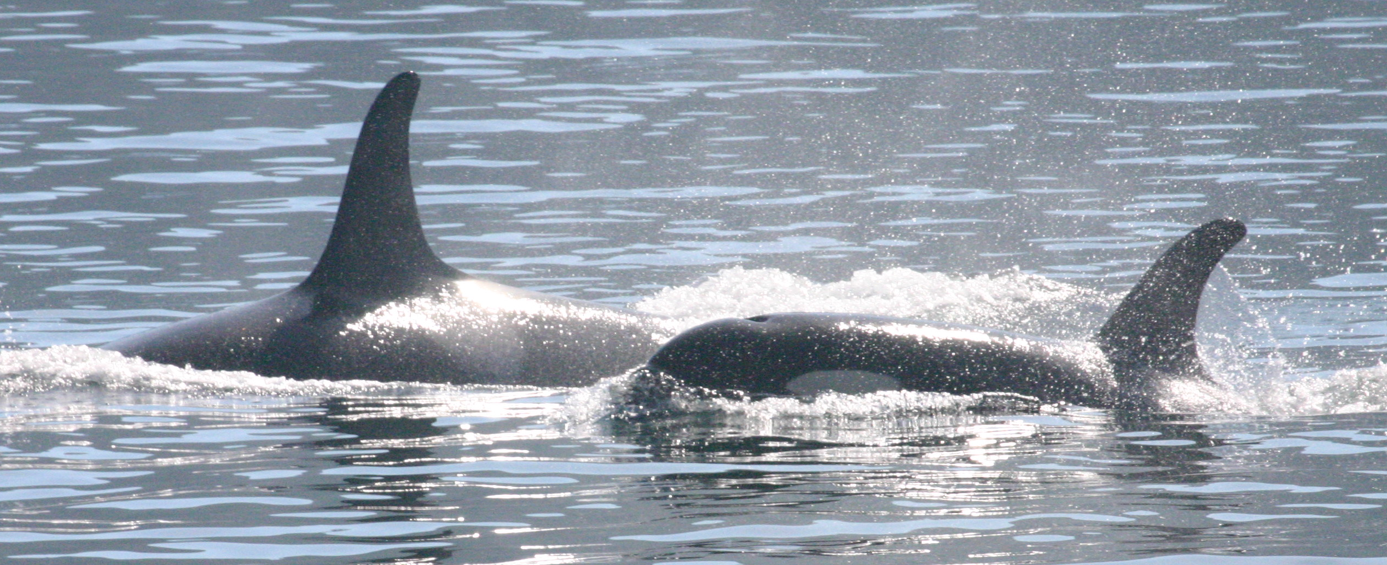
Discussion - SEL
Novel, non-invasive
Similar range to captive studies
Signal to noise

Slide 13
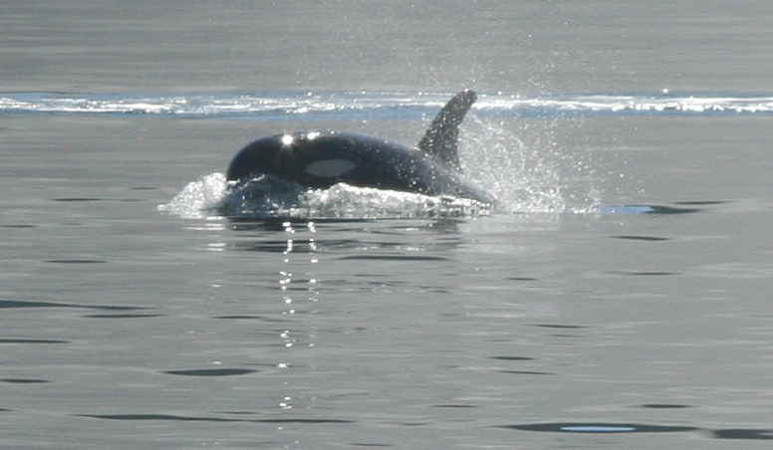
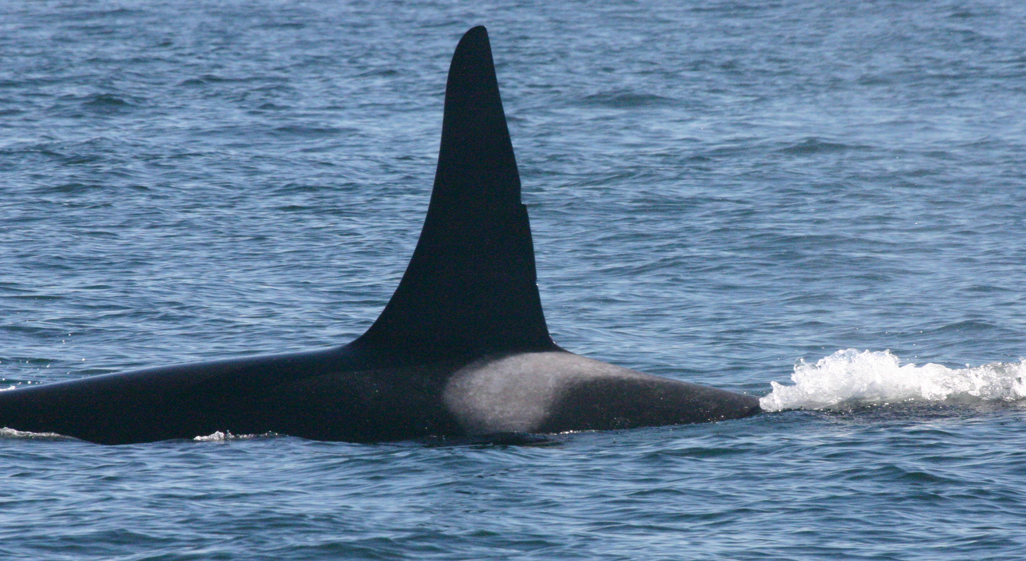
Further study
Extend this study
COT
Inhalation
Behaviour-based model

Slide 14
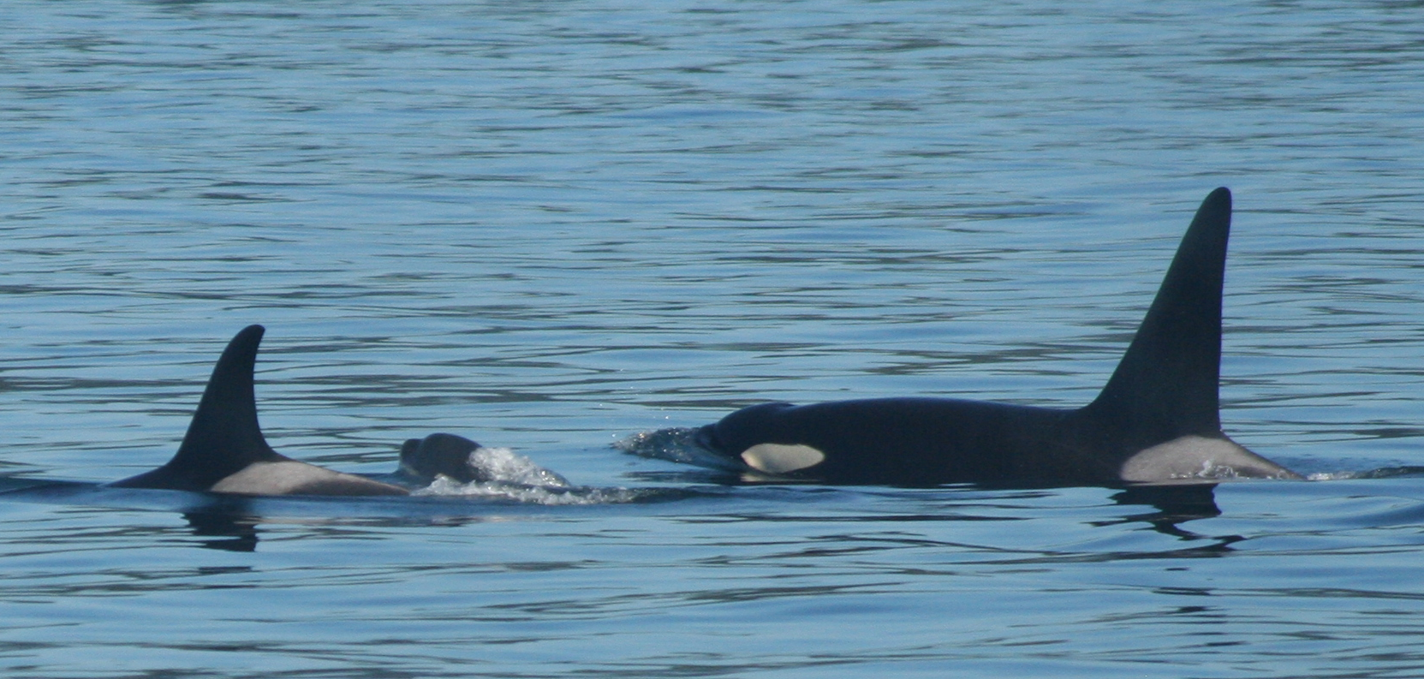
Concluding statements
Estimating metabolic rate from the behavioural states of free-ranging individuals, by combining acoustic cue data from the field with oxygen consumption and tidal volume information from captive individuals, allows for the non-invasive study of the marine mammals.
This study suggests complex energetic associations with social system.

Slide 15
Acknowledgements
I would like to thank:
Jason Wood, Val Veirs and Scott Veirs for constructive comments and guidance in all aspects of this study. I would especially like to thank Jason for trusting me with his Microphone.
Todd Schuster for allowing the use of his vessel over the study period.
All who provided data on the whale locations throughout the study period. Without you we would have a lot less data.
Finally Hana Kazunas, Garrett Turner, Megan Stoltzfus, Vannessa Victoria and Dave Cade for assistance cooperation and support with data collection. Thank you for making this experience so fun and memorable.

Slide 16
Questions?

