Slide 1
Investigating the Effect of Large Vessel Noise on Southern Resident Killer Whales
Hilary B. Rollins
UC Davis
Beam Reach Marine Science and Sustainability School
hbrollins@gmail.com

Slide 2
Introduction
Southern Resident killer whales depend on communication
Anthropogenic noise can mask killer whale calls
Large vessels (ships) produce the majority of the background noise in Haro Strait
Large vessel noise is very consistent and very loud and concentrated in low frequencies

Slide 3
Hypothesis
Whales will be forced to compensate for ship noise to maintain necessary communication and will change their acoustic behavior
This experiment will test changes in call duration, fundamental frequency, and power ratio depending on ship absence or presence

Slide 4
Methods
Calibrated Labcore hydrophone array was towed and sounds were recorded on Sound Device 702s
Ship absence/presence was monitored using AIS, recorded by Ship Locator software and determined by a range of 5 NM
Behavior states, boats within .5 NM, and sea state were monitored

Slide 5
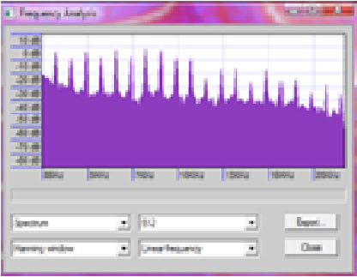
Methods
S1 calls measured for call duration, fundamental frequency, power ratio
0.5 seconds of background noise measured within 3 seconds of each call
141 calls measured

Slide 6
S1 Call Factors
 | Average | Minimum | Maximum
Duration (seconds) | 1.00936 | 0. 704811 | 1.649056
Fundamental Frequency (Hz) | 1061.667 | 572 | 1453
Power Ratio (relative dB) | 0.06383 | -20 | 13

Slide 7
Results
Background noise varies significantly with ship absence/presence and boat count (P-value: 0.012149, 0.000394)

Slide 8
Results
 | Background Noise | Boat Count | Ship Absence/ Presence
Duration | No significance, P-value=0.543694 | No significance, P-value=0.566138 | No significance, P-value=0.841500
Fundamental Frequency | No significance, P-value=0.948566 | No significance, P-value=0.828676 | No significance, P-value=0.884519
Power Ratio | No significance, P-value=0.412809 | No significance, P-value=0.623204 | No significance, P-value=0.693920

Slide 9
Results

Slide 10
Results

Slide 11
Discussion
Sample size
Total behavior comparison
AIS
Variation in ship noise depending on design
Alternate methods of vocal compensation

Slide 12
Acknowledgements
Many, many thanks to...
Dr. Jason Wood, Dr. Val Veirs, Dr. Scott Veirs, Erica Beneze, Hannah McGowan, Peter Valenzuela, Matt Williams,
Captain Todd Shuster, Captain Mike Kramer, and the captains of the whale watch fleet

Slide 13
Any Questions?

